Slide 1


Department of BES-1
Data Structures through Python
24SC1204
Topic:
Graphs Representation – Adjacency Matrix
Session - 35

Slide 2



AIM OF THE SESSION
To familiarize students with the basic concept of Graph Representation and its application
INSTRUCTIONAL OBJECTIVES
This Session is designed to:
Demonstrate : Graph.
Describe : Types of Graph
Describe :Graph Terminology
Representation of Graph’s
List out the :Applications Graph.
LEARNING OUTCOMES
At the end of this session, you should be able to:
Define : Graph
Describe : Types of Graph and Graph Terminology.
Representation of graph’s
Summarize : Application of Graph.

Slide 3
GRAPH INTRODUCTION
What is a Graph?
Definition:Graphs are mathematical structures that represent pairwise relationships between objects.
It can be visualized by using the following two basic components:
Nodes:Nodes are entities whose relationships are expressed using edges.
Edges: Edges are the components that are used to represent the relationships between various nodes in a graph.
Note: A graph is often viewed as a generalization of the tree structure, where instead of having a purely parent-to-child relationship between tree nodes, any kind of complex relationship can exist.

Slide 4
Why are Graphs Useful?
Graphs are widely used to model any situation where entities or things are related to each other in pairs. For example, the following information can be represented by graphs:
Example:
1.Family trees in which the member nodes have an edge from parent to each of their children.
2.Transportation networks in which nodes are airports, intersections, ports, etc. The edges can be airline flights, one-way roads, shipping routes, etc.

Slide 5
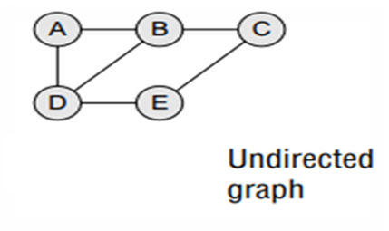
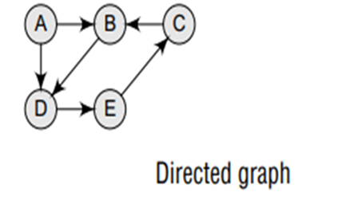
Definition:
A graph G is defined as an ordered set (V, E), where V(G) represents the set of vertices and E(G) represents the edges that connect these vertices. Figure.1 shows a graph with V(G) = {A, B, C, D and E} and E(G) = {(A, B), (B, C), (A, D), (B, D), (D, E), (C, E)}. Note that there are five vertices or nodes and six edges in the graph.
A graph can be directed or undirected. In an undirected graph, edges do not have any direction associated with them. That is, if an edge is drawn between nodes A and B, then the nodes can be traversed from A to B as well as from B to A. Figur shows an undirected graph because it does not give any information about the direction of the edges
Look at Figure.2 which shows a directed graph. In a directed graph, edges form an ordered pair. If there is an edge from A to B, then there is a path from A to B but not from B to A. The edge (A, B) is said to initiate from node A (also known as initial node) and terminate at node B (terminal node)

Slide 6
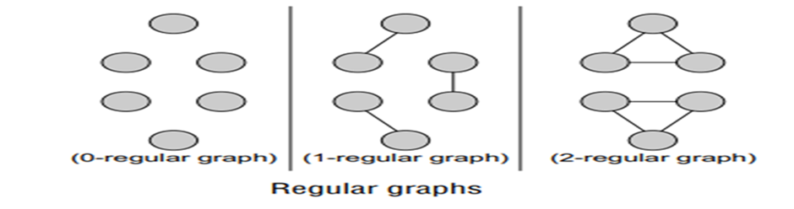
Graph Terminology
Adjacent nodes or neighbours :For every edge, e = (u, v) that connects nodes u and v, the nodes u and v are the end-points and are said to be the adjacent nodes or neighbors.
Degree of a node : Degree of a node u, deg(u), is the total number of edges containing the node u. If deg(u) = 0, it means that u does not belong to any edge and such a node is known as an isolated node.
Regular graph : It is a graph where each vertex has the same number of neighbors. That is, every node has the same degree. A regular graph with vertices of degree k is called a k–regular graph or a regular graph of degree k. Figure shows regular graphs.

Slide 7
Path: A path P written as P = {v0 , v1 , v2 , ..., vn ), of length n from a node u to v is defined as a sequence of (n+1) nodes. Here, u = v0 , v = v n and vi–1 is adjacent to vi for i = 1, 2, 3, ..., n.
Closed path: A path P is known as a closed path if the edge has the same end-points. That is, if v0 = vn .
Simple path: A path P is known as a simple path if all the nodes in the path are distinct with an exception that v0 may be equal to vn . If v0 = vn , then the path is called a closed simple path.
Cycle : A path in which the first and the last vertices are same. A simple cycle has no repeated edges or vertices (except the first and last vertices).
Connected graph: A graph is said to be connected if for any two vertices (u, v) in V there is a path from u to v. That is to say that there are no isolated nodes in a connected graph. A connected graph that does not have any cycle is called a tree. Therefore, a tree is treated as a special graph (Refer Fig. b).

Slide 8
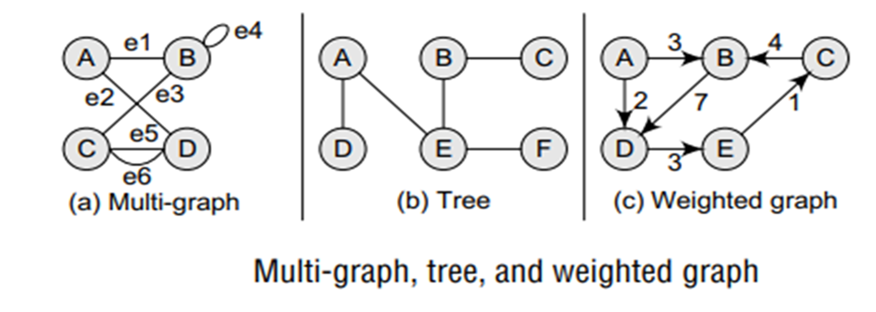
Complete graph: A graph G is said to be complete if all its nodes are fully connected. That is, there is a path from one node to every other node in the graph. A complete graph has n(n–1)/2 edges, where n is the number of nodes in G.
Clique : In an undirected graph G = (V, E), clique is a subset of the vertex set C Õ V, such that for every two vertices in C, there is an edge that connects two vertices.

Slide 9
Labelled graph or weighted graph: A graph is said to be labelled if every edge in the graph is assigned some data. In a weighted graph, the edges of the graph are assigned some weight or length. The weight of an edge denoted by w(e) is a positive value which indicates the cost of traversing the edge. Figure .c shows a weighted graph.
Multiple edges : Distinct edges which connect the same end-points are called multiple edges. That is, e = (u, v) and e' = (u, v) are known as multiple edges of G. Loop An edge that has identical end-points is called a loop. That is, e = (u, u).
Multi-graph: A graph with multiple edges and/or loops is called a multi-graph. Figure. a shows a multi-graph.
Size of a graph: The size of a graph is the total number of edges in it
Maximum number of edges: The maximum number of edges in an undirected graph with n vertices is n(n−1)/2. In a directed graph, it is n(n−1).

Slide 10
Directed Graphs:
A directed graph G, also known as a digraph, is a graph in which every edge has a direction assigned to it. An edge of a directed graph is given as an ordered pair (u, v) of nodes in G. For an edge (u, v),
The edge begins at u and terminates at v.
u is known as the origin or initial point of e. Correspondingly, v is known as the destination or terminal point of e.
u is the predecessor of v. Correspondingly, v is the successor of u.
Nodes u and v are adjacent to each other
Terminology of a Directed Graph:
Out-degree of a node: The out-degree of a node u, written as outdeg(u), is the number of edges that originate at u.
In-degree of a node: The in-degree of a node u, written as indeg(u), is the number of edges that terminate at u.

Slide 11
Degree of a node :The degree of a node, written as deg(u), is equal to the sum of in-degree and out-degree of that node. Therefore, deg(u) = indeg(u) + outdeg(u).
Isolated vertex: A vertex with degree zero. Such a vertex is not an end-point of any edge. Pendant vertex (also known as leaf vertex) A vertex with degree one.
Cut vertex: A vertex which when deleted would disconnect the remaining graph.
Source: A node u is known as a source if it has a positive out-degree but a zero in-degree.
Sink: A node u is known as a sink if it has a positive in-degree but a zero out-degree.
Reachability: A node v is said to be reachable from node u, if and only if there exists a (directed) path from node u to node v. For example, if you consider the directed graph given in Fig. (a), you will observe that node D is reachable from node A.

Slide 12
Strongly connected directed graph: A digraph is said to be strongly connected if and only if there exists a path between every pair of nodes in G. That is, if there is a path from node u to v, then there must be a path from node v to u.
Unilaterally connected graph: A digraph is said to be unilaterally connected if there exists a path between any pair of nodes u, v in G such that there is a path from u to v or a path from v to u, but not both
Weakly connected digraph: A directed graph is said to be weakly connected if it is connected by ignoring the direction of edges. That is, in such a graph, it is possible to reach any node from any other node by traversing edges in any direction (may not be in the direction they point). The nodes in a weakly connected directed graph must have either out-degree or in-degree of at least 1. Parallel/Multiple edges: Distinct edges which connect the same end-points are called multiple edges. That is, e = (u, v) and e' = (u, v) are known as multiple edges of G. In Fig.(a), e3 and e5 are multiple edges connecting nodes C and D.

Slide 13
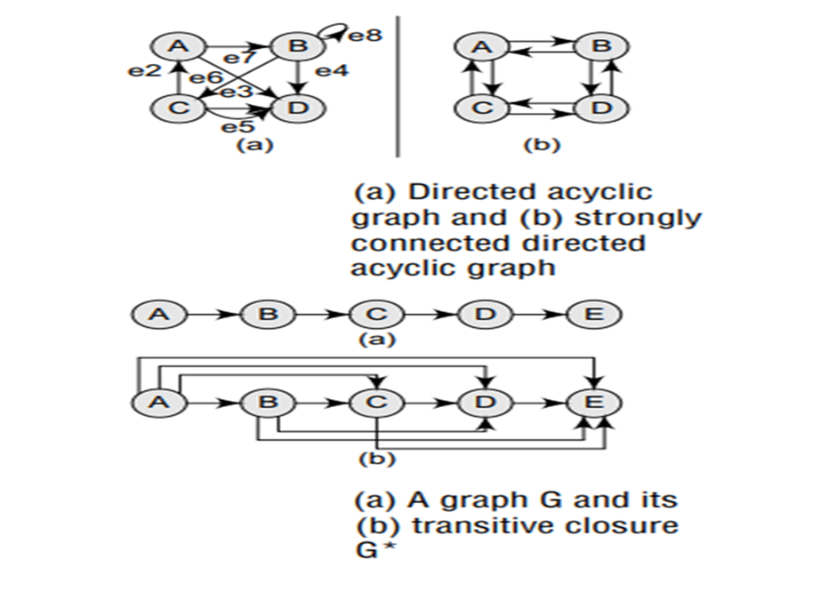
Simple directed graph: A directed graph G is said to be a simple directed graph if and only if it has no parallel edges. However, a simple directed graph may contain cycles with an exception that it cannot have more than one loop at a given node.
The graph G given in Fig.(a) is a directed graph in which there are four nodes and eight edges. Note that edges e3 and e5 are parallel since they begin at C and end at D. The edge e8 is a loop since it originates and terminates at the same node. The sequence of nodes, A, B, D, and C, does not form a path because (D, C) is not an edge. Although there is a path from node C to D, there is no way from D to C.
In the graph, we see that there is no path from node D to any other node in G, so the graph is not strongly connected. However, G is said to be unilaterally connected. We also observe that node D is a sink since it has a positive in-degree but a zero out-degree

Slide 14
REPRESENTATION OF GRAPHS
There are three common ways of storing graphs in the computer’s memory. They are:
Sequential representation by using an adjacency matrix.
Linked representation by using an adjacency list that stores the neighbours of a node using a linked list.
Adjacency multi-list which is an extension of linked representation. In this section, we will discuss both these schemes in detail.
Adjacency Matrix Representation: An adjacency matrix is used to represent which nodes are adjacent to one another. By definition, two nodes are said to be adjacent if there is an edge connecting them.
In a directed graph G, if node v is adjacent to node u, then there is definitely an edge from u to v. That is, if v is adjacent to u, we can get from u to v by traversing one edge. For any graph G having n nodes, the adjacency matrix will have the dimension of n x n

Slide 15
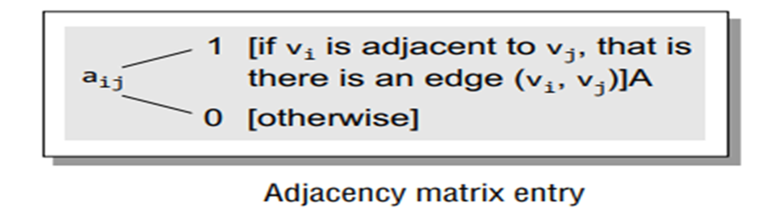
In an adjacency matrix, the rows and columns are labelled by graph vertices. An entry aij in the adjacency matrix will contain 1, if vertices vi and vj are adjacent to each other. However, if the nodes are not adjacent, aij will be set to zero. It is summarized in Fig.
Since an adjacency matrix contains only 0s and 1s, it is called a bit matrix or a Boolean matrix. The entries in the matrix depend on the ordering of the nodes in G. Therefore, a change in the order of nodes will result in a different adjacency matrix. Figure shows some graphs and their corresponding adjacency matrices.

Slide 16
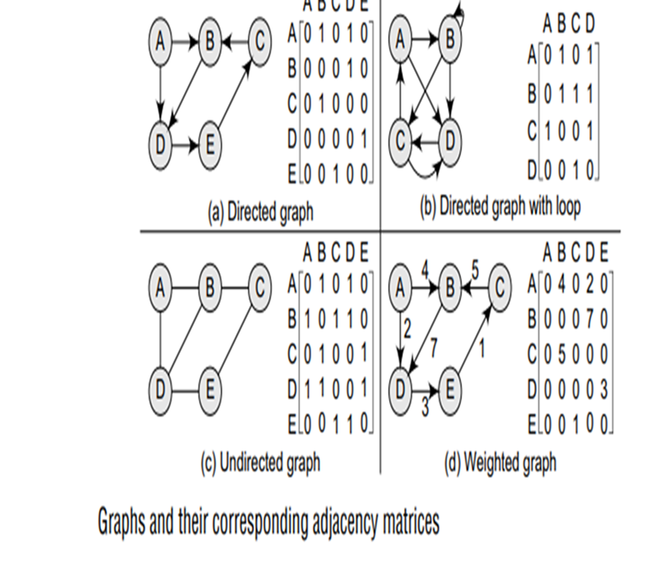

Slide 17
From the above examples, we can draw the following conclusions:
For a simple graph (that has no loops), the adjacency matrix has 0s on the diagonal.
The adjacency matrix of an undirected graph is symmetric.
The memory use of an adjacency matrix is O(n2 ), where n is the number of nodes in the graph.
Number of 1s (or non-zero entries) in an adjacency matrix is equal to the number of edges in the graph.
The adjacency matrix for a weighted graph contains the weights of the edges connecting the nodes

Slide 18
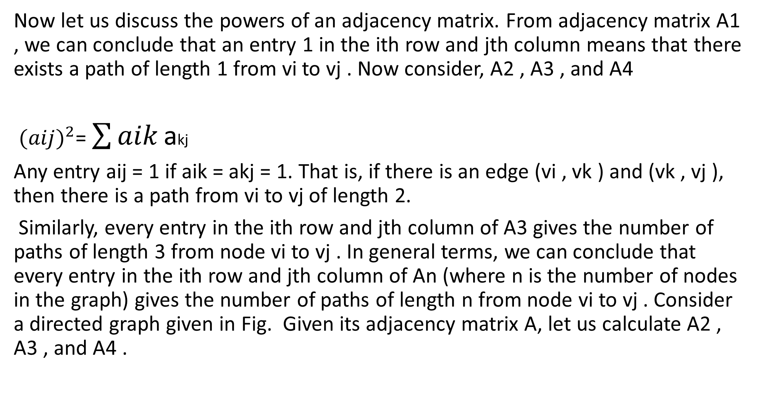
Now let us discuss the powers of an adjacency matrix. From adjacency matrix A1 , we can conclude that an entry 1 in the ith row and jth column means that there exists a path of length 1 from vi to vj . Now consider, A2 , A3 , and A4
${(aij)}^{2}$= $\sum{aik}$ akj
Any entry aij = 1 if aik = akj = 1. That is, if there is an edge (vi , vk ) and (vk , vj ), then there is a path from vi to vj of length 2.
Similarly, every entry in the ith row and jth column of A3 gives the number of paths of length 3 from node vi to vj . In general terms, we can conclude that every entry in the ith row and jth column of An (where n is the number of nodes in the graph) gives the number of paths of length n from node vi to vj . Consider a directed graph given in Fig. Given its adjacency matrix A, let us calculate A2 , A3 , and A4 .

Slide 19
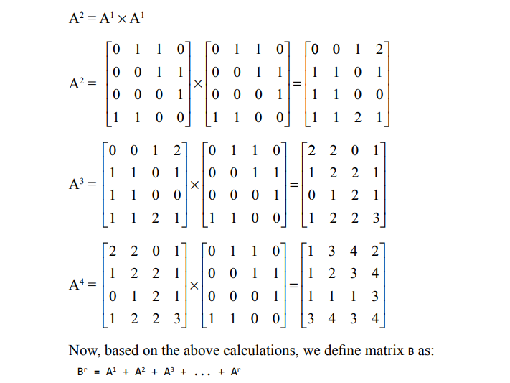
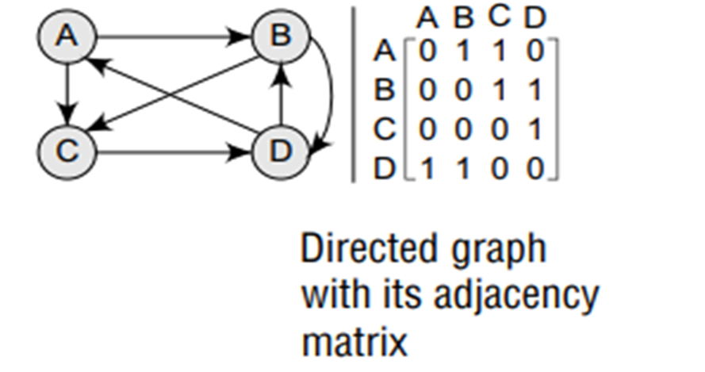

Slide 20
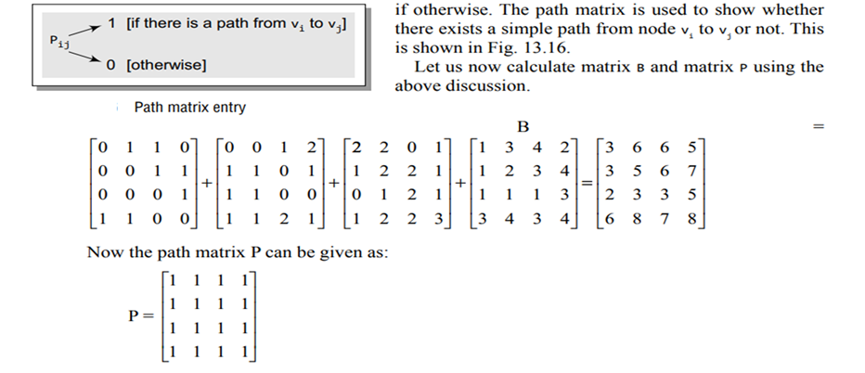
An entry in the ith row and jth column of matrix Br gives the number of paths of length r or less than r from vertex vi to vj . The main goal to define matrix B is to obtain the path matrix P. The path matrix P can be calculated from B by setting an entry Pij = 1, if Bij is non-zero and Pij = 0,

Slide 21
SUMMARY
An Adjacency Matrix is a way to represent a graph as a two-dimensional matrix. It is particularly useful for dense graphs or when quick access to information about edges is required.
Adjacency matrices are most useful for dense graphs or when edge existence needs to be checked frequently. However, for sparse graphs or scenarios requiring efficient edge traversal, adjacency lists are usually preferred.

Slide 22
SELF-ASSESSMENT QUESTIONS
1. What does the entry A[i][j]A[i][j]A[i][j] in an adjacency matrix represent for an undirected graph?
a) The weight of the edge from vertex I to j.
b) Whether there is an edge from i to j (1 for yes, 0 for no).
c) The number of edges connected to vertex i.
d) The shortest distance from i to j.
2. Which of the following is not true for an adjacency matrix??
A. It is space-efficient for dense graphs.
b) It is easy to check whether an edge exists between two vertices.
c) It is space-efficient for sparse graphs.
d) It supports weighted graphs by storing weights instead of 1s.
3. Which of the following graph algorithms can efficiently use an adjacency matrix?
a) Dijkstra’s algorithm for shortest path.
b) Floyd-Warshall algorithm for all-pairs shortest paths.
c) Depth-First Search (DFS).
d) Kruskal’s Minimum Spanning Tree algorithm.

Slide 23
TERMINAL QUESTIONS
What is an adjacency matrix, and how is it used to represent graphs?
Explain the differences in adjacency matrices for undirected, directed, and weighted graphs.
3. Describe how to count the number of edges in a graph using its adjacency matrix

Slide 24
REFERENCES FOR FURTHER LEARNING OF THE SESSION
TEXTBOOKS:
1. Mark Allen Weiss, Data Structures and Algorithm Analysis in C, 2010, Second Edition, Pearson Education.
2. Allen B. Downey, ”Think Python: How to Think Like a Computer Scientist’’, 2nd edition, Updated for Python 3, Shroff/O’Reilly Publishers, 2016 (http://greenteapress.com/wp/thinkpython/)
3. Data Structures and algorithms using python, 2011,Rance D, Necaise, himilton printing
REFERENCE BOOKS:
1. Data Structures and Algorithm Analysis in PYTHON, 2010, Mark Allen Weiss, Second Edition, Pearson Education.
2. Data Structures and Algorithms, A.V.Aho, J.E.Hopcroft, and J.D.Ullman, Pearson Education, First Edition Reprint2003.
3. Advanced Guide to Python 3 Programming, John Hunt, 4th Edition, Springer Nature Switzerland AG 2019.
4. Python Basics: A Practice Introduction to Python 3, David Amos, Dan Bader, Joanna Jablonski, Fletcher Heisler, 4th edition, Real Python..
WEB REFERNCES/MOOCS:
1. https://docs.python.org/3/tutorial/datastructures.html
2. https://www.w3schools.com/dsa/dsa_intro.php
3. https://www.geeksforgeeks.org/python-data-structures/

Slide 25
THANK YOU
Team – Data Structures through Python

